Slide 1


Strings in C-Programming
Presented by:- Swetali Mohanty

Slide 2

Introduction
Strings are array of characters i.e. they are characters arranged one after another in memory. Thus, a character array is called string.
Each character within a string is stored within one element of the array successively.
A string is always terminated by a null character (i.e. slash zero "\0").

Slide 3
Strings....
Operations performed on string includes:-
Reading and writing string.
Copying one string to another.
Combining two string.
Comparing string for equality.
Extracting a portion of string.

Slide 4
Declaration of string
A string variable is declared as an array of characters.
Syntax:-
char string_name[size];
E.g. char name[20];
When the compiler assigns a character string to a character array, it automatically supplies a null character ('\0') at the end of the string.

Slide 5
Initializing String Variables
Strings are initialized in either of the following two forms:
char name[6] = {'S','W','E','T','A','\0'};
char name[] = {'S','W','E','T','A','\0'};
OR
char name[6] = "SWETA";
char name[] = "SWETA";
When we initialize a character array by listing its elements, the null terminator or the size of the array must be provided explicitly.
S | W | E | T | A | \0
name[0] | name[1] | name[2] | name[3] | name[4] | name[5]

Slide 6
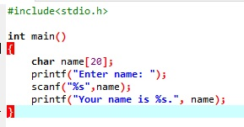
Reading and displaying String
This is an example of string as input and output using scanf and printf

Slide 7
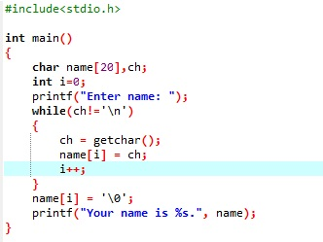
It can also be done manually using getchar()
This is an example of string reading and storing using getchar().

Slide 8
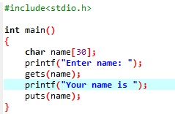
using gets() and puts()
This is an example of string read and write using gets() and puts().

Slide 9
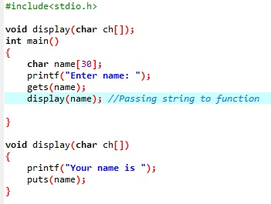
Passing string to function
The code is an example of passing an string to an function named display.

Slide 10
String handling functions
Strings need to be manipulated by programmer.
It can be done manually but it is time consuming such as:-
Counting length of the string
Copying one string to another
So, to make string handling simpler and faster there are various string handling functions defined in string.h .

Slide 11
Some of the string handling functions are:
Functions | Work of Function
strlen() | It gives the length of the passed string
strcpy() | copies a string to another
strcat() | Merges two strings
strcmp() | Compares two strings
strlwr() | Converts string to lowercase
strupr() | Converts string to uppercase

Slide 12
Array of Strings
String is an array of characters.
Thus, an array of string is 2-D array of characters.
E.g.
Char student[5][10];
Here, student[5][10] means 5 student having 10 character each.

Slide 13
Thankyou!

